Slide 1
Problem Solving with 3 Algorithms
Algorithm and Their Applications
신철호

Slide 2
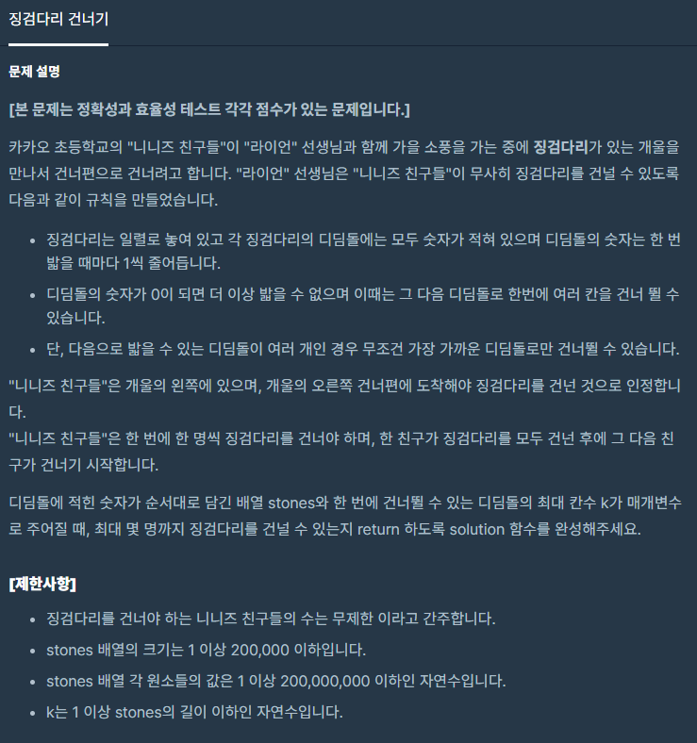
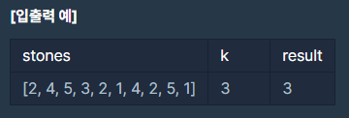
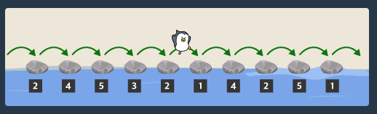
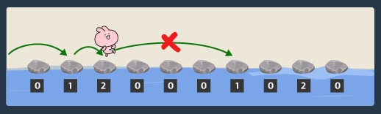
Problem Definition
contents
01

Slide 3

BruteForce
contents
02
Approach
ㆍ When a person crosses a stream, decrease the value of each element in the list by 1.
ㆍ Search the updated list. If the length of a successive zero element is less than k, repeat the above process.
ㆍ Break the loop ,When the length of a successive zero element is k.
Time Complexity
$$T\left(n\right)=O{(n}^{2})$$

Slide 4
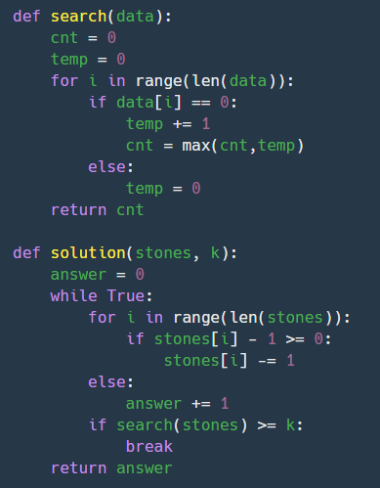
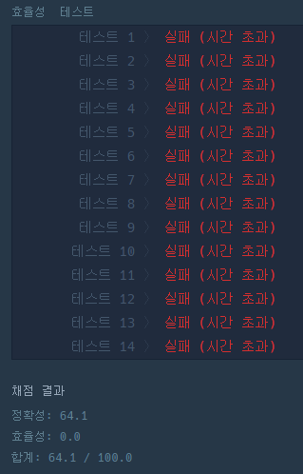
BruteForce
contents
03

Slide 5
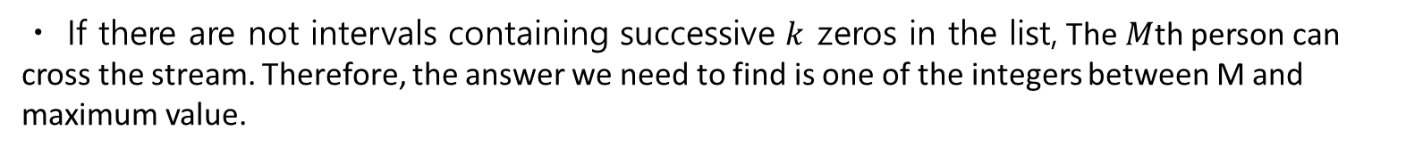
BinarySearch
contents
04
Approach
ㆍ Assume that everyone, up to the M-1th person, crossed the stream regardless of the value of K
Case1)
ㆍ If there are intervals containing successive $k$ zeros in the list, The $M$th person cannot cross the stream. Therefore, the answer we need to find is one of the integers between 0 and M – 1
Case2)
ㆍ If there are not intervals containing successive $k$ zeros in the list, The $M$th person can cross the stream. Therefore, the answer we need to find is one of the integers between M and maximum value.
ㆍLet initial middle point be [min(stones)+max(stones)]/2

Slide 6

BinarySearch
contents
05
Time Complexity
ㆍThe number of times $m$ divided by 2 is $k$. That is, proceed with the comparison operation k times.
ㆍWhen there is only one data left, it can be explained as one last comparison operation.
ㆍWe can express this as for the worst case.
$$T\left(m\right)=k+1$$
$m×{\left(\frac{1}{2}\right)}^{k}=1 ⟹$ $m$=$2^{k}$ $⟹$ $\log_{2}{m}=k$ $∴T\left(m\right)=k+1= \log_{2}{m}$ +1 $∈O(\log_{2}{m}$)
ㆍSearch the number of consecutive zeros $⟹$ $O(n$)
$$O\left(n\log_{2}{m}\right)$$
$where n is the number of stones, m is maximum value of the number written on the stones$

Slide 7
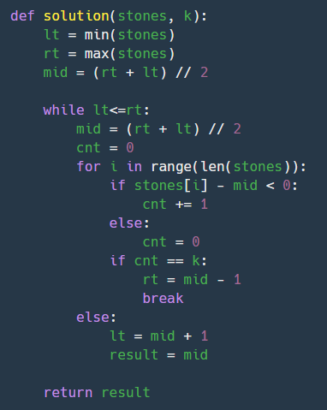
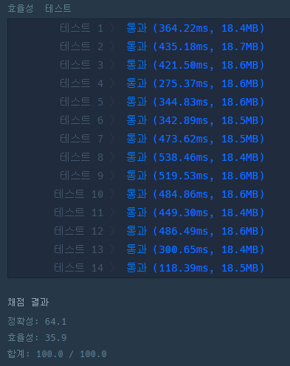
BinarySearch
contents
06

Slide 8
SlidingWindow
contents
07
ㆍList with $n$elements
ㆍThe window's width is $w$
ㆍStarting from the left, move the window to the right one space at a time
ㆍSearch for information inside the window every moment
1 | 4 | 3 | 2 | 6 | 8 | 4 | 3 | 7 | 9

Slide 9
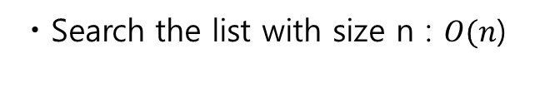
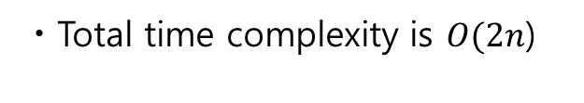
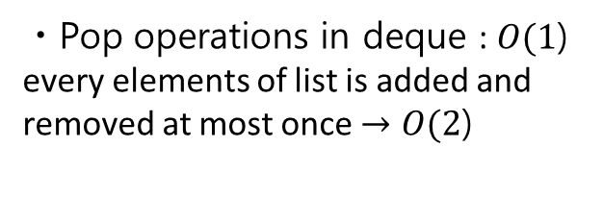
SlidingWindow
contents
08
Approach
ㆍFind the minimum value of the maximum values from each of the windows
Time Complexity
ㆍSearch the list with size n : $O(n$)
ㆍPop operations in deque : $O(1$) every elements of list is added and removed at most once $→O(\text{2}\text{)}$
ㆍTotal time complexity is $O(2n$)

Slide 10
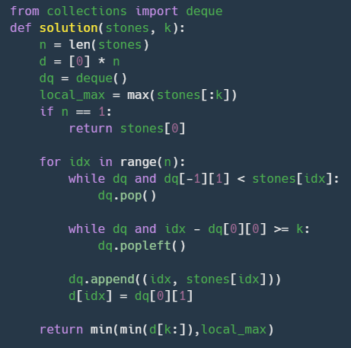
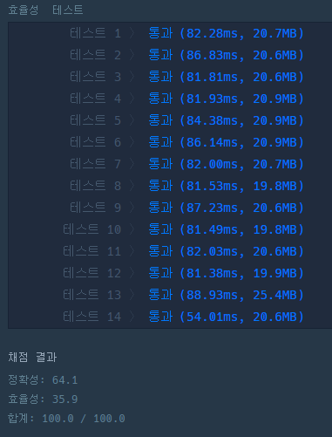
SlidingWindow
contents
09

Slide 11
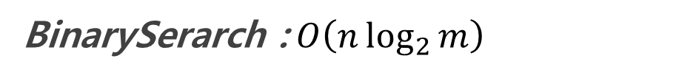
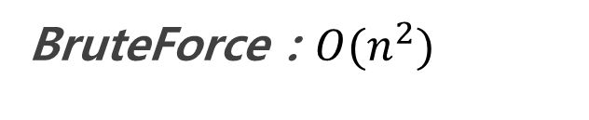
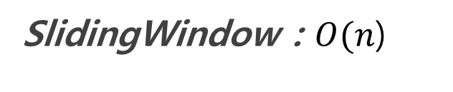
Conclusion
contents
10
BruteForce : $O{(n}^{2})$
BinarySerarch :$O\left(n\log_{2}{m}\right)$
SlidingWindow : $O(n$)

Slide 12
Thank You
contents
10

